Slide 1
Web Development(Server)
Lecture 2
Arrays
Loops
Regular Expressions

Slide 2
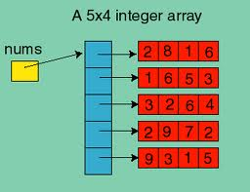
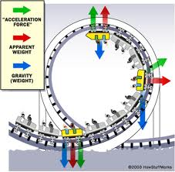
This Week
Arrays
Loops
Regular Expressions

Slide 3
Web Applications
Loops
For & While
Do
Arrays in PHP
Indexed arrays
Associative arrays
Searching arrays
Sorting arrays
Loops & Arrays
For
Foreach
While
Do-while
Regular Expressions
Regular expressions
Examples
  - phone / email/name

Slide 4
For Loop
Similar to C and Java:
  simpleFor.php
    <h1>A simple for loop</h1>
    <? for ($i = 0; $i < 10; $i++) {
      echo "$i <br>\n";
      } // end for loop
      ?>
  Exercises:
    Count backwards from 10 …1
    Count in 5s to 50
  See video on For Loop: http://wally.cs.iupui.edu/n342/

Slide 5
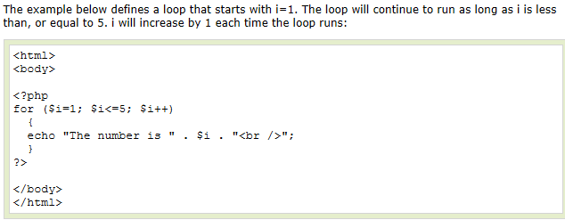
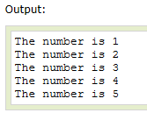
For Loop Example

Slide 6
While Loop
<?
$i = 1;
while ($i <= 10){
  echo "$i <br>\n";
  $i++;
  } // end while
?>

Slide 7
do while loop
Similar to C and Java
do
{
Statements
} while (condition)

Slide 8
Web Applications
Arrays in PHP
  Indexed arrays
  Associative arrays
  List() operation
  Searching arrays
  Sorting arrays
  See video on Arrays : http://wally.cs.iupui.edu/n342/

Slide 9
Two types of arrays in PHP
Indexed arrays
  the indices are 0, 1, 2, ....
  these are like arrays in C or Java
Associative arrays
  indices are strings (keys)
  Any values can be stored in an array

Slide 10
1. Creating indexed arrays
Creating and initializing an array
  Use the array() function to create an array
  $a = array(10, 20, "Help");
  Each item is separated by a comma
  Can specify as many items as you like
  Can specify item of any type
  By default, index number start at zero, and arrays are assumed to be zero-based.

Slide 11
1. Creating indexed arrays cont.
  $a[0] is 10, $a[1] is 20, $a[2] is "Help“
Can extend the array dynamically
  $a[] = 30; // this is $a[3]
Creating an array by autovivification
  $b[0] = 10;
  $b[1] = 20;
  $b[] = "Help"; // next element
  $b[] = 30; // next element

Slide 12


Slide 13
Question
Create an array containing the 4 seasons.
Display – The first season is …
The second season is ….

Slide 14
Question
Given the following code, what is the output?
<?php
$n = array(1, 2, 3, 4);
echo $n[3];
?>
A. 1 B. 2 C. 3 D. 4

Slide 15
Question
Given the following code, what is the output?
  <?php
  $n = array(1, 2, 3, 4);
  echo $n[0]+$n[3];
  ?>
A. 5 B. 6 C. 7 D. 8

Slide 16
1. Indexed arrays from ranges
$digits = range(0,9);
  $digits[0] is 0,
  $digits[1] is 1, ...
  $digits[?] is 6
  $digits[?] is 9
$letters = range('a', 'z');
  $letters[0] is 'a',
  $letters[1] is 'b', ...
  $letters[?] is ‘z'

Slide 17
1. Indexed array slices
array_slice(array, offset,
length)
  returns a subarray with length elements of array begining at offset
Extracts $letters[5] to $letters[14] as $slice[0] to $slice[9]
$letters = range('a', 'z');
$slice = array_slice($letters, 5, 10);

Slide 18
2. Associative arrays
An associative array is a table of key-value pairs.
Here the names are the keys and the values are the ages.
$age = array( 'Fred' => 37, 'Gord' => 23,
'Alice' => 17, 'Bob' => 23 );
echo "Fred's age is ", $age['Fred'];
$age['Fred'] = 65; // Fred is now a senior
echo "<br/>Fred's age is {$age['Fred']}";
Note braces needed for
interpolation

Slide 19
2. Associative arrays
Notice that keys and values are separated by '=>', and each key-value pair is separated by commas.
Use print_r() to view the contents of the array:
  print_r($age);

Slide 20



Slide 21
Question
Create an associative array of the following counties – Dublin, Cork & Galway.
Use the following as keys – D,C, G
Display – Cork is the biggest county.
Notes:
<?php
$counties = array("D" => "Dublin", "C" => "Cork", "G" => "Galway" );
echo $counties['C']. "is the biggest county";
?>

Slide 22
Questions
Given the following code,
  <?php
  $fruit = array("A" => "Apple","B" => "Banana",
  "G" => "Grape", "O" => "Orange"); ?>
Which ans displays:
I like banana!
A. echo "I like " + $fruit["B"] . "!";
B. echo "I like " . $fruit["B"] . "!";
C. echo "I like " $fruit["B"] "!";
D. echo "I like " + $fruit["B"] + "!";

Slide 23
2. Checking for key existence (1)
array_key_exists(key, array)
  returns true if the given key exists in the array. If the key exists it may or may not be null.
  Here "key exists" is displayed (also see is_null)
$product = array('id' => 1, 'desc' => null,
'price' => 2.50);
if (array_key_exists('desc', $product))
{ echo 'key exists'; }
else
{ echo 'key does not exist'; }

Slide 24
2. Checking for key existence (2)
isset(array['key'])
  returns true if the given key exists in the array and is not null
  Here "key does not exist or is null" is displayed
$product = array('id' => 1, 'desc' => null,
'price' => 2.50);
if (isset($product['desc']))
{ echo 'key exists and is not null'; }
else
{ echo 'key does not exist or is null'; }

Slide 25
Convert array --> variables (extract)
The extract function converts an array to variables
  This creates the variables my_number, my_name, my_balance with the values 123, "Fred", and 45.50
  There is an inverse function called compact
$account = array('number' => 123, 'name' => 'Fred',
'balance' => 45.50);
extract($account, EXTR_PREFIX_SAME, "my");

Slide 26
Searching Arrays
in_array(element, array)
in_array(element, array,TRUE)
  returns true if the given element is found in the given array (TRUE option for same types)
array_search(element, array)
array_search(element, array,TRUE)
  returns the key of the element if found, else returns false (TRUE option for same types)

Slide 27
Sorting arrays (1)
sort(array)
  sort array in ascending alphabetical or numerical order or
rsort(array)
  sort in reverse alphabetical or numerical order
$names = array('Fred', 'Ted', 'Barney', 'Gord');
sort($names); // 'Barney','Fred','Gord','Ted'
print_r($names);
rsort($names); // 'Ted','Gord','Fred','Barney'
print_r($names);

Slide 28
Sorting arrays (2)
asort(array), arsort(array)
  sort associative array by values in ascending or descending order
  The order is increasing order of age
$ages = array('Fred' => 34, 'Ted' => 45,
'Barney' => 23, 'Gord' => 15);
asort($ages); // 'Gord','Barney,'Fred','Ted'
print_r($ages);

Slide 29
Sorting arrays (3)
ksort(array), krsort(array)
  sort associative array by keys in ascending or descending order
  The order is ascending alphabetical order of the names
$ages = array('Fred' => 34, 'Ted' => 45,
'Barney' => 23, 'Gord' => 15);
ksort($ages); // 'Barney','Fred','Gord','Ted'
print_r($ages);

Slide 30
Other array functions
There are many other array functions
  Get the size of an array .. count($arr) or sizeof($arr)
  sorting multiple arrays
  array_walk, and array_reduce
  merging two arrays
  shuffle() – reorders an array
  etc.

Slide 31
Using an array to display a random image
Create an array of images:
<?php
$pictures = array('andrew.jpg','margaret.jpg','laura.jpg', 'nancy.jpg','steven.jpg','anne.jpg', 'janet.jpg', 'michael.jpg', 'robert.jpg');
shuffle($pictures);
?>

Slide 32
Using an array to display a random image
Display three randomly chosen images
<table width = 100%>
<tr>
<?php
for ($i = 0; $i <3; $i++){
echo "<td align = 'center' >";
echo "<img src = '/mugshots/“ . $pictures[$i] . "'>";
echo "</td>";
}
?>
</tr>
</table>
path to folder

Slide 33
Web Applications
LOOPS + arrays
  For
  Foreach
Scripts: loops.php

Slide 34
The for loop
Similar to C and Java:
Use For loop with array() & count()
for ($count = 1; $count <= 10; $count++)
{
echo "$count ";
}
$ages = array(34, 45, 56, 65);
for ($i = 0; $i < count($ages); $i++)
{
echo $age[$i], ' ';
}

Slide 35
The for loop
Use For loop with array() & sizeof()
$ages = array(34, 45, 56, 65);
for ($i = 0; $i < sizeof($ages); $i++)
{
echo $age[$i], ' ';
}

Slide 36
The foreach loop (1)
Useful for indexed arrays when the loop index is not needed as in preceding example:
  Here $age successively takes on the array values
  INEFFICIENT: foreach makes a copy of array
$ages = array(34, 45, 56, 65);
foreach ($ages as $age)
{
echo $age, ' ';
}

Slide 37
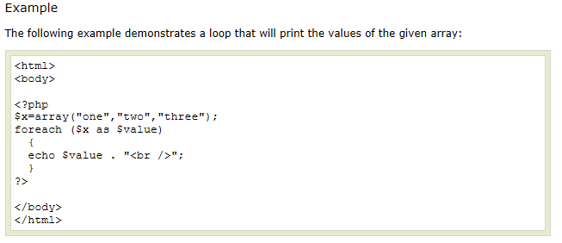

The foreach loop (1)

Slide 38
The foreach loop (2)
Useful for processing associative arrays
  $key and $value are successively the keys and values in the $product array
  What is the output from above?
$product = array('id' => 23,
'desc' => 'No-name PC', 'price' => 549.99);
foreach ($product as $key => $value)
{
echo "Key = $key, Value = $value<br>";
}

Slide 39


Slide 40
Questions
$a = array(1, 3, 5, 7);
Use a foreach loop to display each value in the array.
$a = array("one" => 1,"three" => 3,"five" => 5,"seven" => 7);
Use a foreach loop to display each key & value in the array.
Notes:
foreach ($ages as $age)
{
echo $age;
}
$numbers = array("one" => 1, "two" => 2, "three" => 3 );
foreach ($numbers as $key => $value)
{
echo "The key is ". $key. "</br>";
echo "The value is ". $value. "</br>";
}

Slide 41
Web Applications
Using Regular Expressions

Slide 42
Regular expressions (1)
Regular expressions provide a powerful way to do pattern matching:
  finding one pattern in another.
The simplest patterns are fixed strings like those in the searching function strpos.
However patterns can represent complex classes of strings.
Useful for validating strings

Slide 43
Regular expressions (2)
preg_match(pattern, string)
  returns true if match for pattern was found in string.
  For a case insensitive search, put "i" after the pattern delimiter
  (preg_match("/php/i", "PHP is..”)
preg_replace(pattern,replace,string)
  Each occurrence of pattern match in string is replaced by the replace string. Result is returned as a new string

Slide 44
Regular expressions (3)
preg_split(pattern, string)
  splits string into substrings using pattern as the delimiter. The substrings are returned as an array.

Slide 45
Simple Reg Exp Examples (1)
Matching strings containing only digits
  $regexp = "^[0-9]+$";
  preg_match($regexp, "2342123") returns true
  preg_match($regexp, "2124sd") returns false
^ matches the beginning of the string
$ matches the end of the string
[0-9] specifies a range for a character
+ means 1 or more occurrences

Slide 46
Simple Reg Exp Examples (2)
Matching phone numbers of the form
"ddd-ddd-dddd"
$regexp =
"^[0-9]{3}-[0-9]{3}-[0-9]{4}$";
Here the hyphen is a literal character and {3} indicates exactly three occurrences of the preceding character.

Slide 47
Simple Reg Exp Examples (3)
Definition of a valid name is one containing letters, hyphens and apostrophes
$reg_exp = '/^[a-zA-Z\-\']+$/';
$name = “Mike_Hall”;
if ((! preg_match($reg_exp, $name))
{
echo “<br/> Invalid name”;
}

Slide 48
Regular Expression – Email(4)
Use regular expressions to check that an email address entered on a form is correct
Use the preg_match function to match a string to a particular regular expression
Pattern: username@domain.extension
$reg_exp = "/^[a-zA-Z0-9._-]+@[a-zA-Z0-9._-]+\.([a-zA-Z]{2,4})$/";
preg_match($regexp, $email);
WebSite: http://weblogtoolscollection.com/regex/regex.php
NOTE: HTML5 VALIDATES EMAIL ADDRESSES (EXPLORER 9+)

Slide 49
Scripts
Important
  Arrays1
    indexed.php
  Arrays2
    associative.php
  Arrays3
    functions.php
  Sort_
    arrays.php
  Loops
    Loops.php
Extra
  Regular Expressions
    regexp1.php

Slide 50
Summary
Arrays
Loops
Regular Expressions

